Slide 1

Create your first chat with ACS
Batel Zohar

Slide 2






Batel Zohar
Developer Advocate
BatelZohar
batelzohar
batelt@jfrog.com
Notes:
First, a little bit about myself: My name is Batel Zohar and I’m a Developer Advocate at JFrog. Before that I was part of the Support team and the High Touch solution team in JFrog and I was also an embedded engineer before a few years. here I have an amazing doggy name Banjo as you can see in the If you want to get a hold of me later, you can find me on Twitter at BatelZohar. You can also email me at batelt@jfrog.com. I’m always happy to help so don’t hesitate to reach out if you need something!

Slide 3
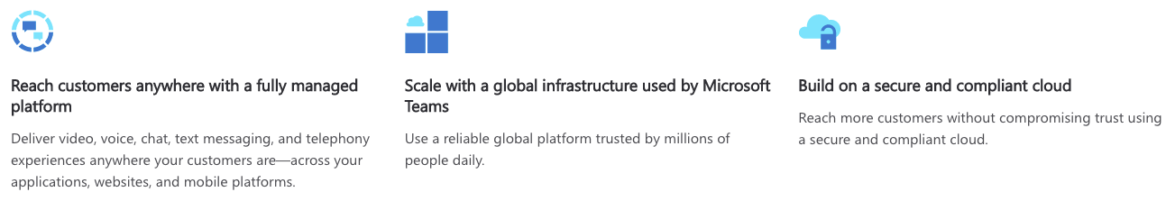
Azure Communication Services
Azure Communication Services is a set of rich communication APIs, video APIs, and SMS APIs for deploying your applications across any device, on any platform. Learn
Notes:
Azure Communication Services is a cloud-based communications service that lets you add voice, video, chat, and telephony to your apps.
With ACS we can deliver video voice chat and SMS anywhere across applications websites and mobile platforms
We can easily scale up with the global infrastructure of Microsoft Teams and we can trust it because they are using a secure and compliant cloud

Slide 4
Overview
This is a sample application to show how the Chat Web SDK can be used to build a single threaded chat experience. The client-side application is a React based user interface which uses Redux for handling complex state while leveraging Microsoft Fluent UI. Powering this front-end is a C# web application powered by ASP.NET Core to connect this application with Azure Communication Services.
Additional documentation for this sample can be found on Microsoft Docs.
Notes:
In this video I’m gonna show you how to create a sample application with a Chat Web SDK that can be used to build a single threaded chat experience.
The client-side application is a React based user interface which uses Redux for handling complex state while leveraging Microsoft Fluent UI. Powering this front-end is a C# web application powered by ASP.NET Core to connect this application with Azure Communication Services.
Additional documentation for this sample can be found on Microsoft Docs.

Slide 5
Prerequisites
Create an Azure account with an active subscription.
Node.js (12.18.4 and above)
Visual Studio (2019 and above) or VScode
.NET Core 3.1
Create an Azure Communication Services resource
Notes:
Create an Azure account with an active subscription.
Node.js (12.18.4 and above)
Visual Studio (2019 and above) or VSCode
.NET Core 3.1 (Make sure to install version that corresponds with your visual studio instance, 32 vs 64 bit)
Create an Azure Communication Services resource. For details, see Create an Azure Communication Resource. You'll need to record your resource connection string for this quickstart.

Slide 6
Code structure
./Chat/ClientApp: frontend client
./Chat/ClientApp/src
./Chat/ClientApp/src/Components : React components to help build the client app chat experience
./Chat/ClientApp/src/Containers : Connects the redux functionality to the React components
./Chat/ClientApp/src/Core : Containers a redux wrapper around the Chat SDK
./Chat/ClientApp/src/index.js : Entry point for the client app
./Chat/Controllers : Server app core logic for client app to get a token to use with the Azure Communication Services Web Chat SDK
./Chat/Program.cs : Server app program logic
./Chat/Startup.cs: Server app startup logic
Notes:
ClientApp which is the frontend client
Controllers - Server app core logic for client app to get the token for the ACS
Program.cs Server app program logic
Startup.cs: Server app startup logic

Slide 7
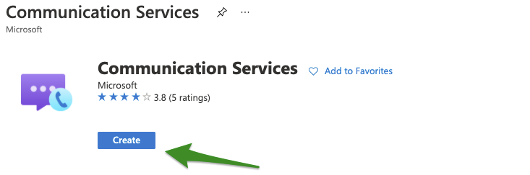
Let’s start !
1. Run the command
$ git clone https://github.com/Azure-Samples/communication-services-web-chat-hero.git
2. Get the Connection String from the Azure portal:
Notes:
First let’s clone the project

Slide 8
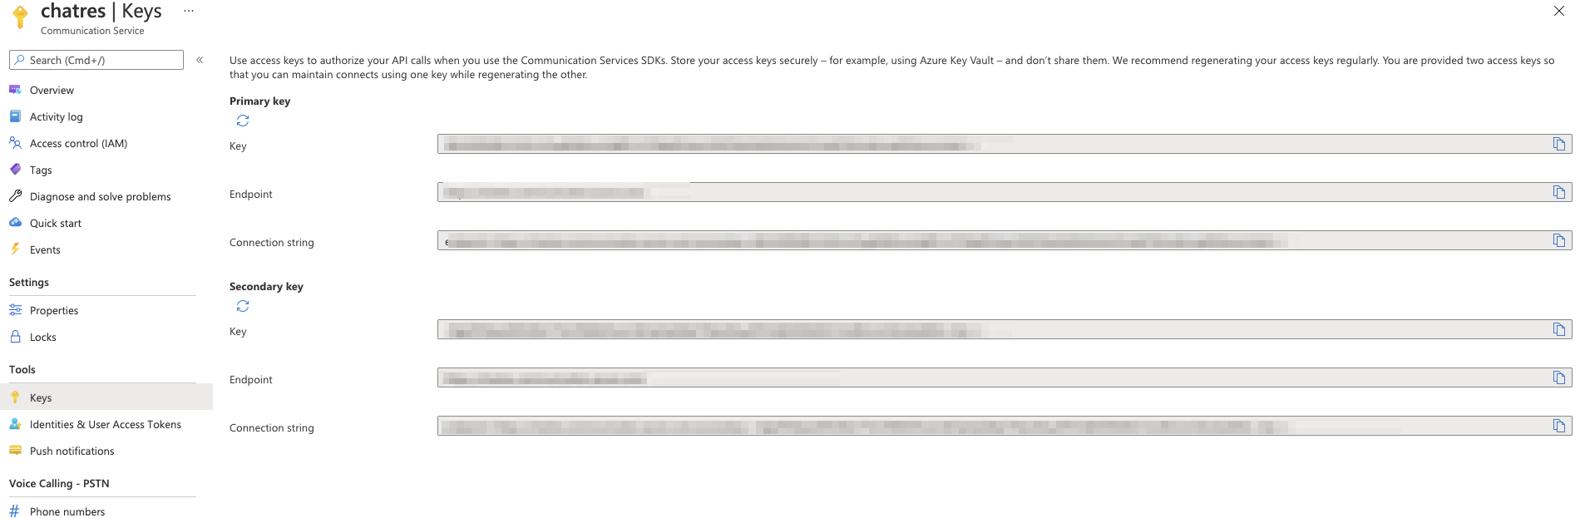
Edit the appsettings.json file
Once you get the Connection String, Add the connection string to the Chat/appsettings.json file found under the Chat folder. Input your connection string in the variable: ResourceConnectionString.

Slide 9
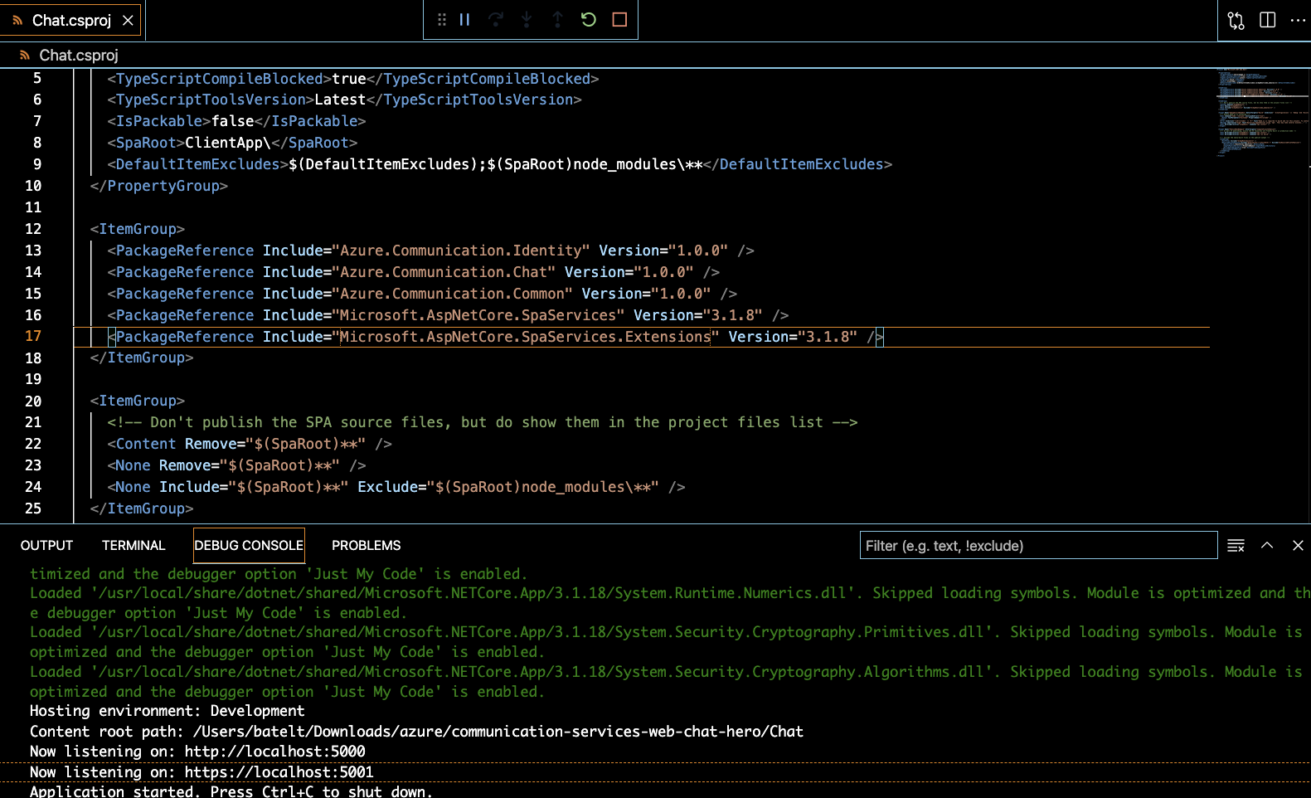
Run your application

Slide 10
Troubleshooting
If we have npm installation / build issues you may want to clean the npm cache with the following command:
$ npm cache clean --force

Slide 11


Slide 12
THANKS
@BatelZohar | batelt@jfrog.com | linkedin.com/in/batelzohar/

